Slide 2
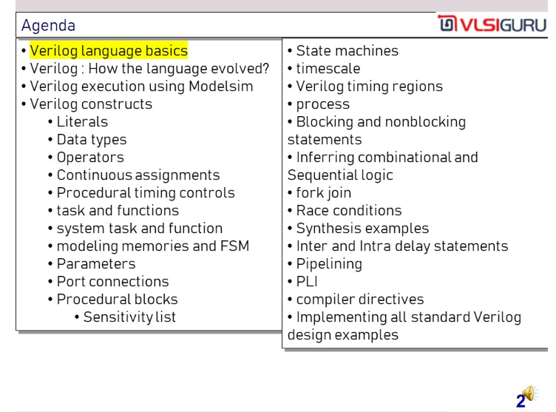

Slide 3
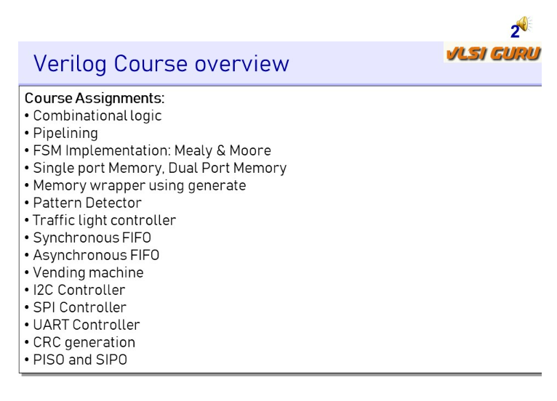

Slide 4
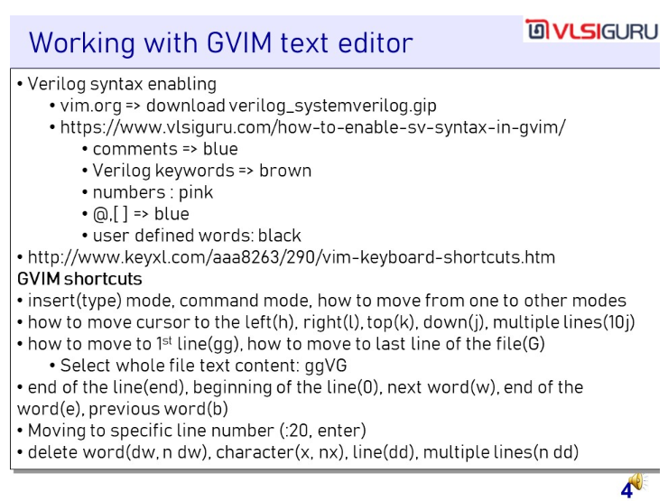

Slide 5
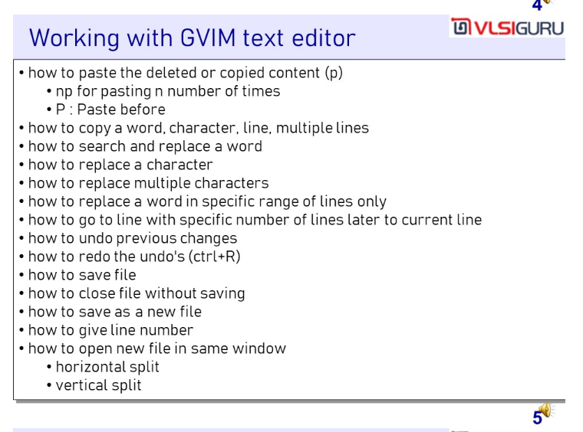

Slide 6
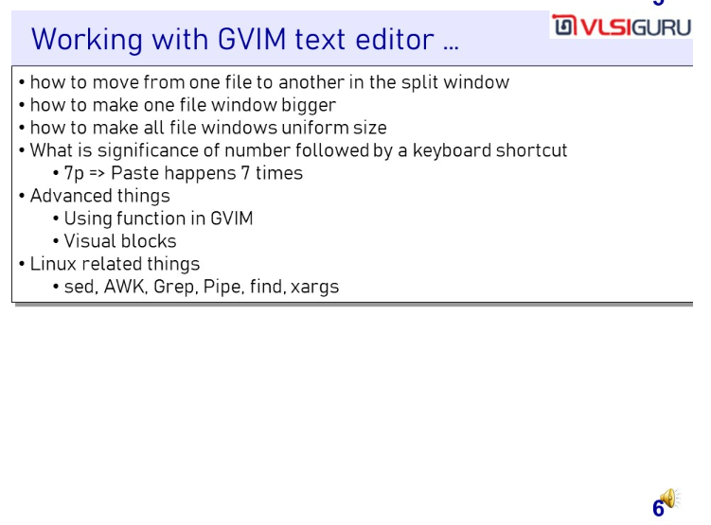

Slide 7
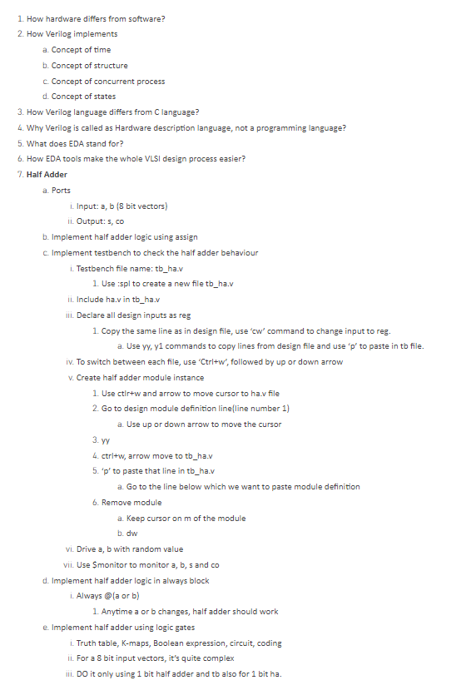

Slide 8
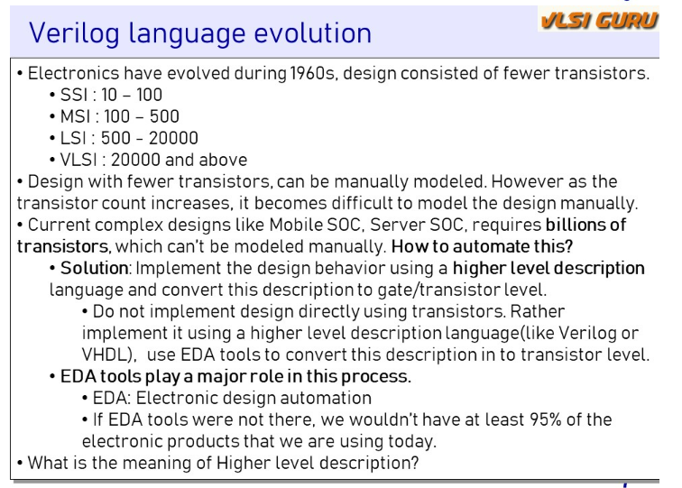

Slide 9
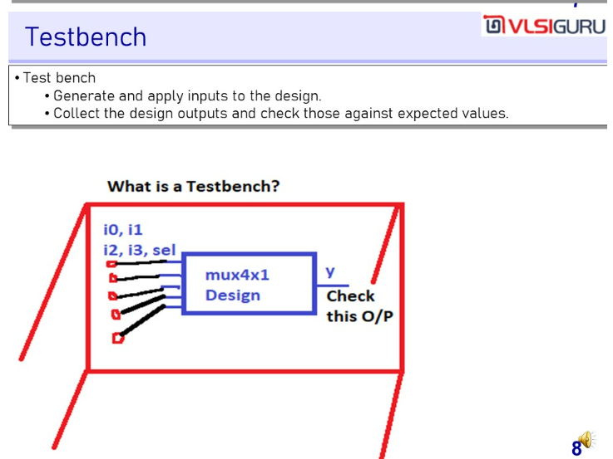

Slide 10
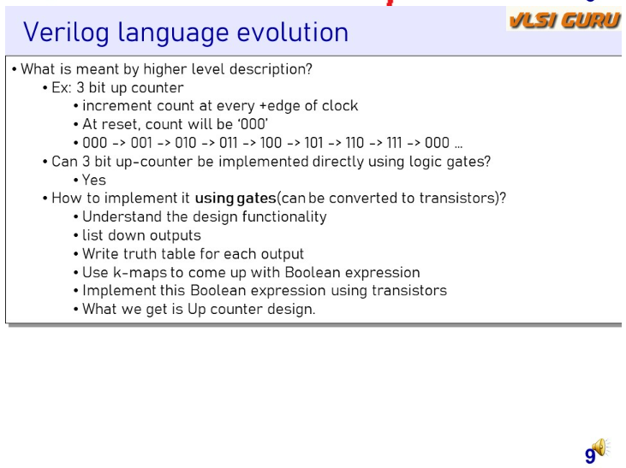

Slide 11
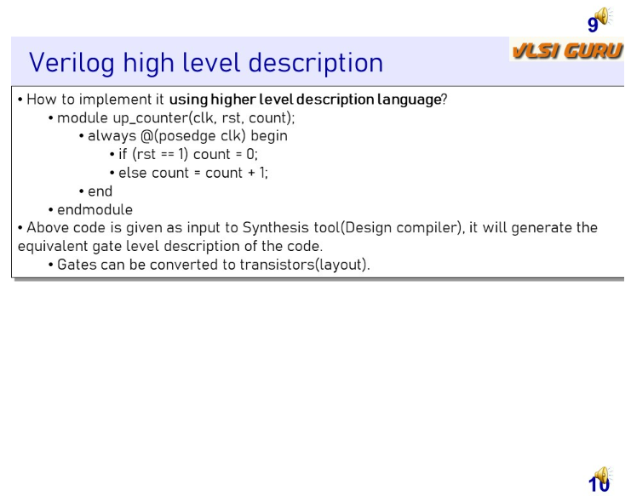

Slide 12
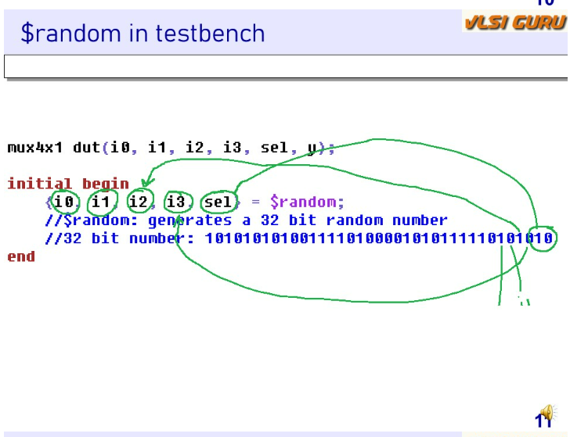

Slide 13
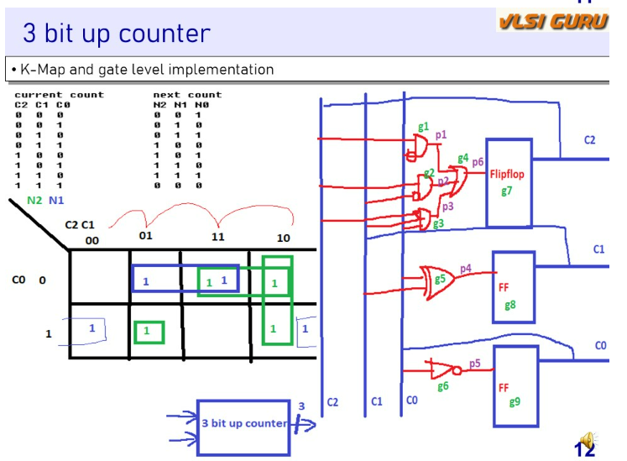
Notice here that expression for DFF is created using excitation table (AND NOT Truth Table)
D2 = ~C0.C2 + C2~C1 + ~C2C1C0
D1 = m(1,2,5,6) = C1~C0 + ~C1C0 = C0^C1
D0 = m(0,2,4,6) = ~C0

Slide 14
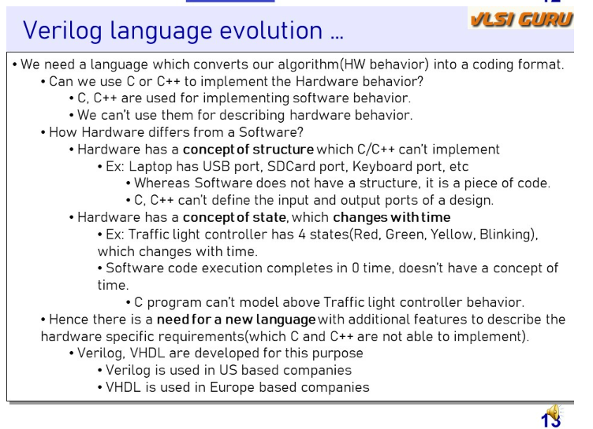

Slide 15
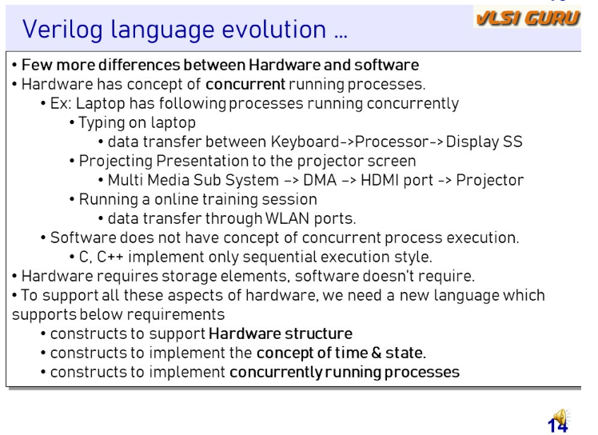

Slide 16
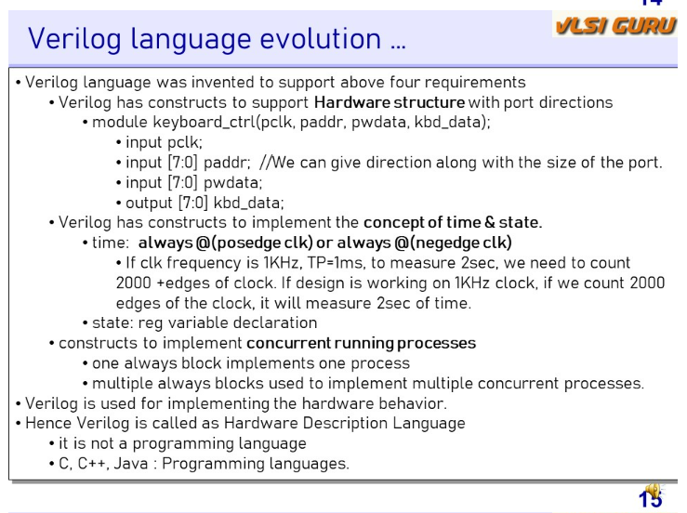

Slide 17
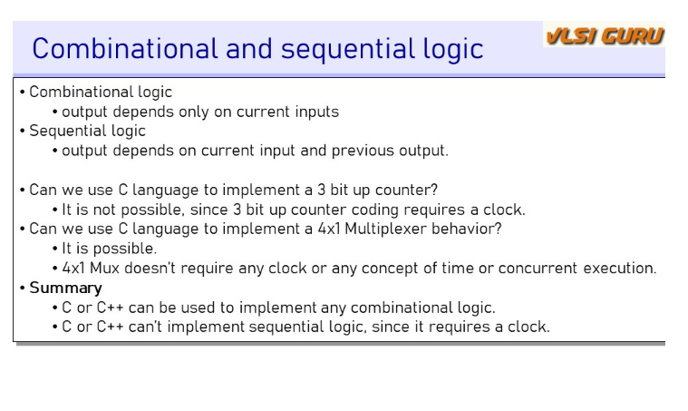

Slide 18

For Behavioral – always is compulsory
For Data Flow Model – assign is compulsory

Slide 19
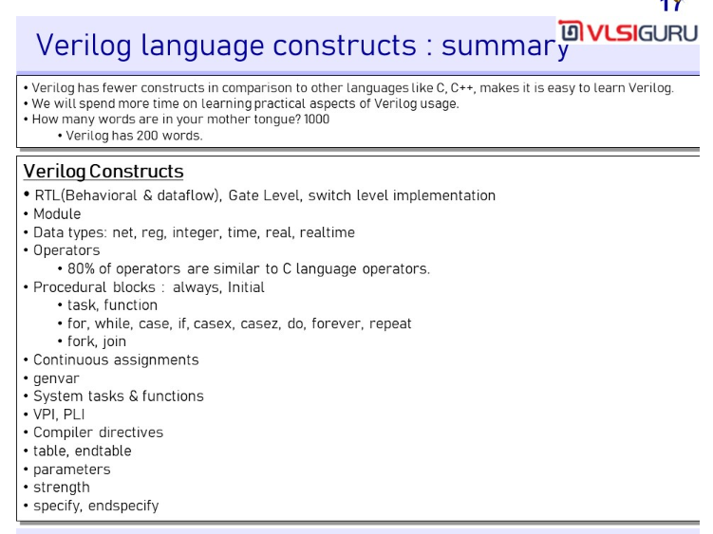

Slide 20
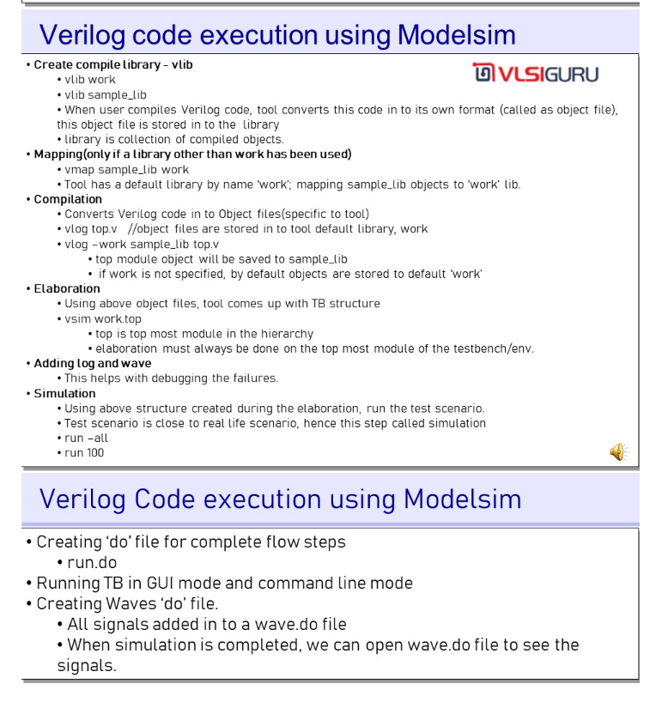

Slide 21
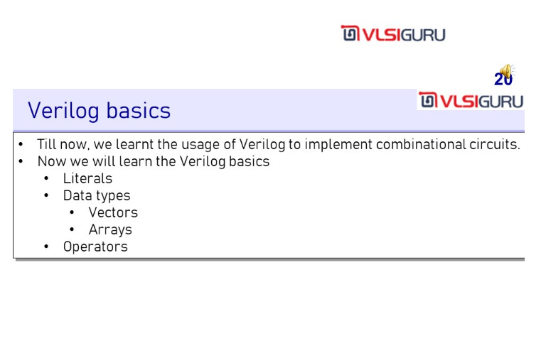

Slide 22
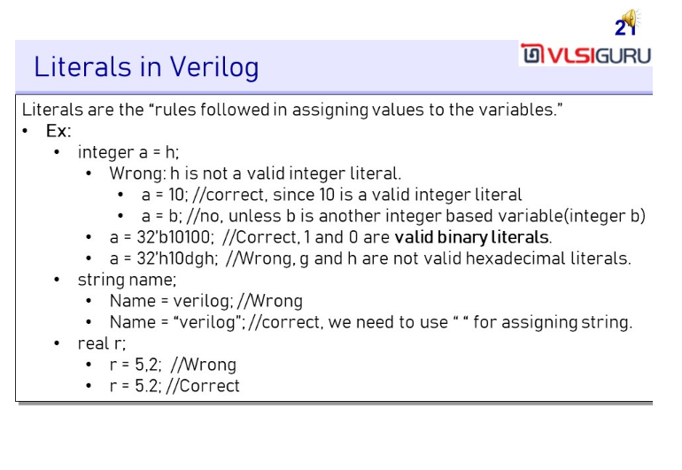

Slide 23
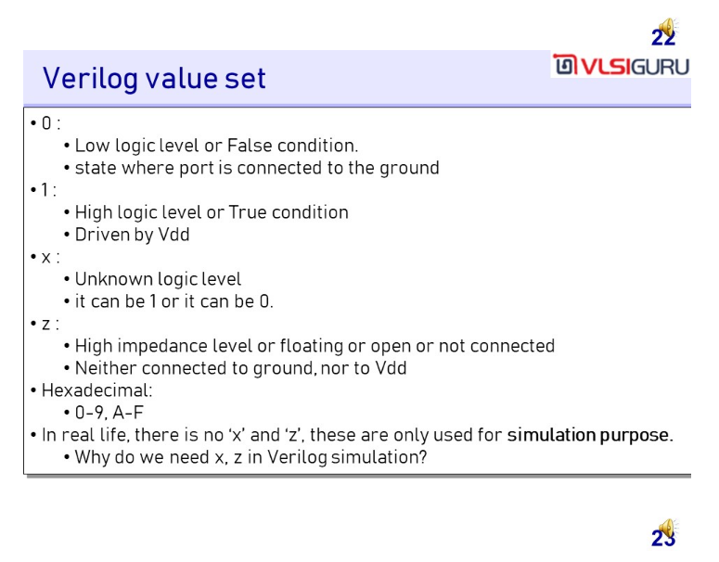

Slide 24
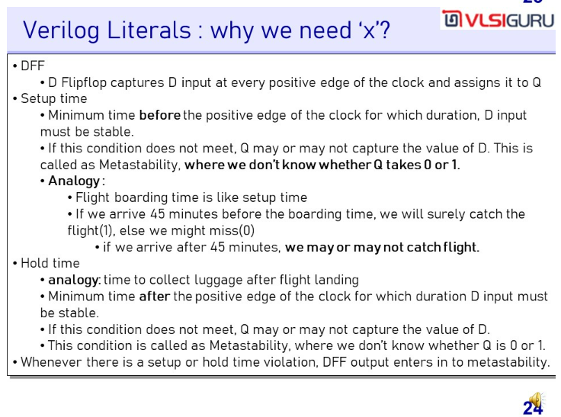

Slide 25
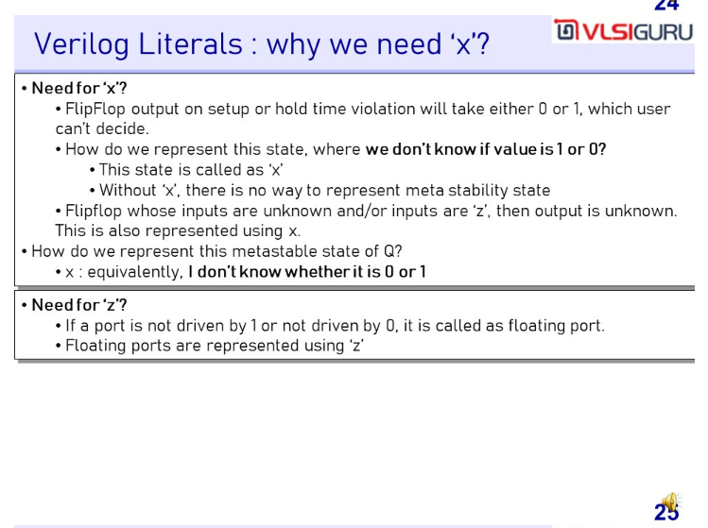

Slide 26
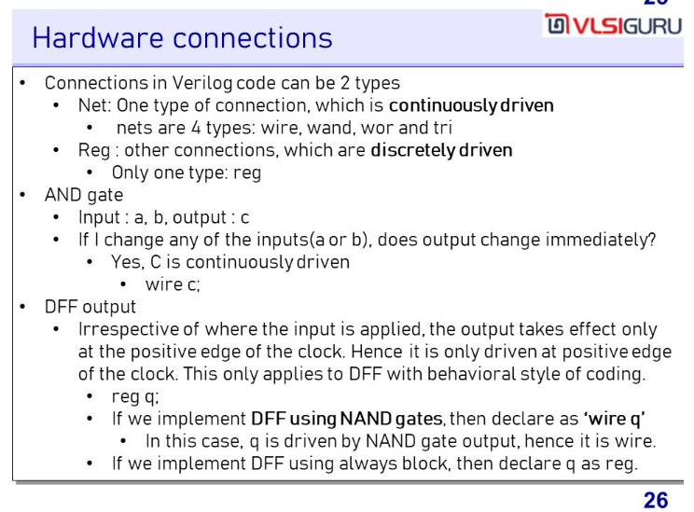

Slide 27
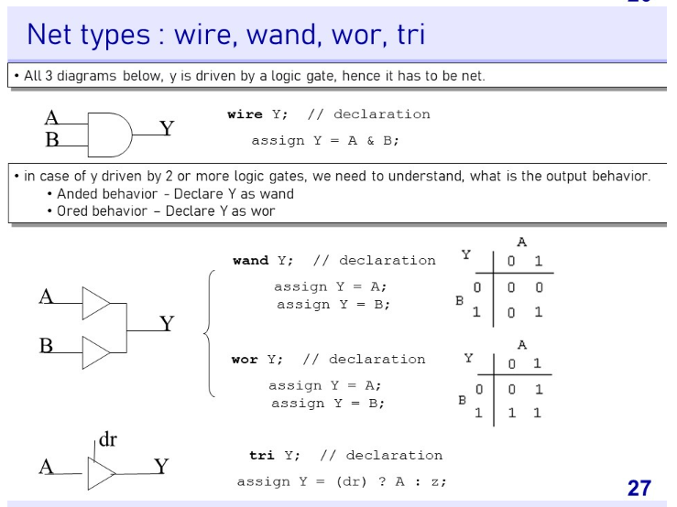

Slide 28
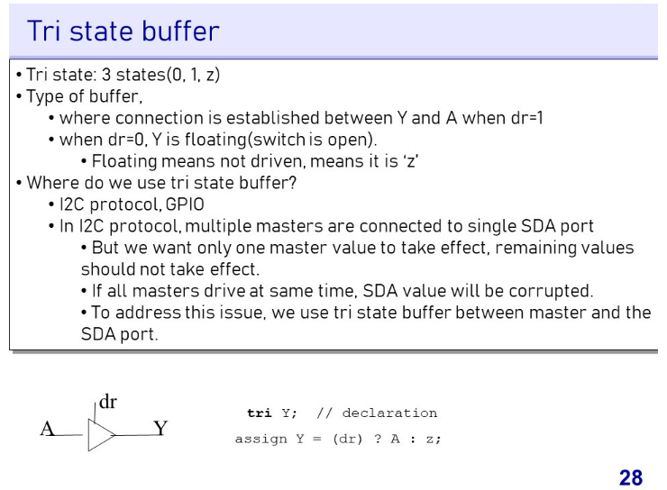

Slide 29
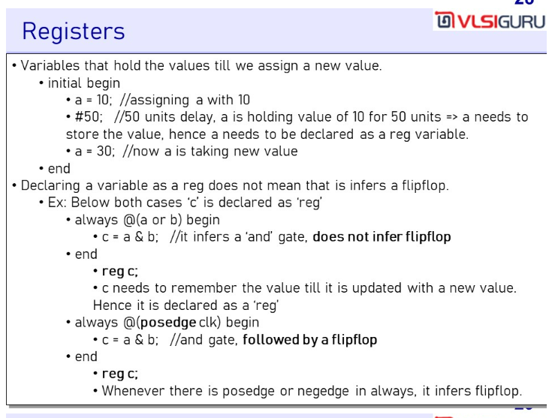

Slide 30
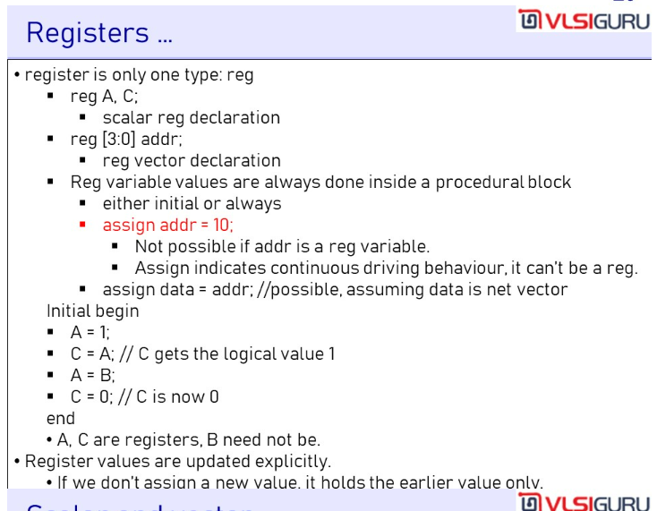

Slide 31
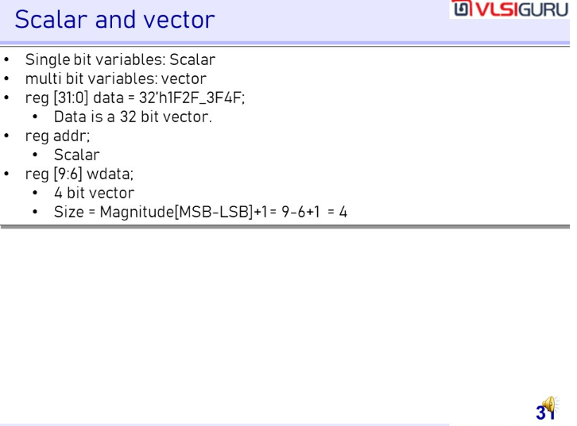

Slide 33
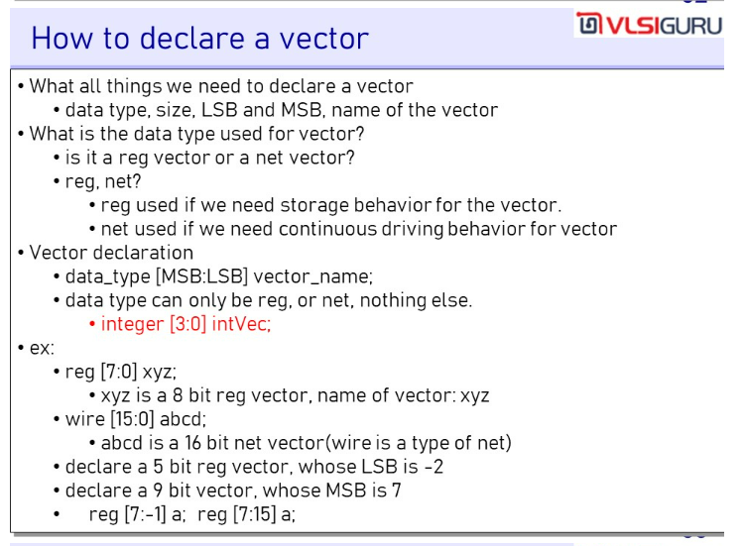

Slide 34
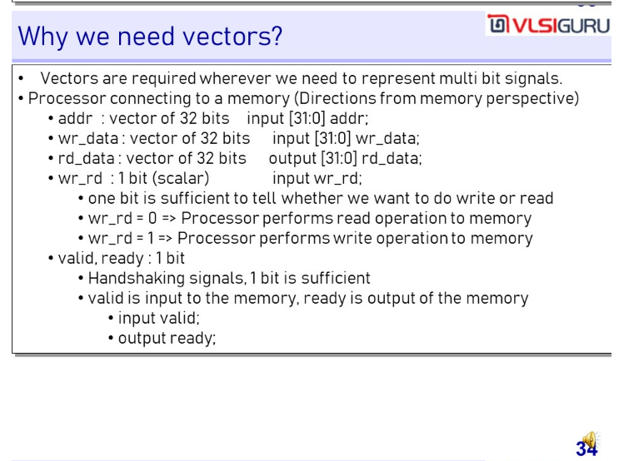

Slide 35
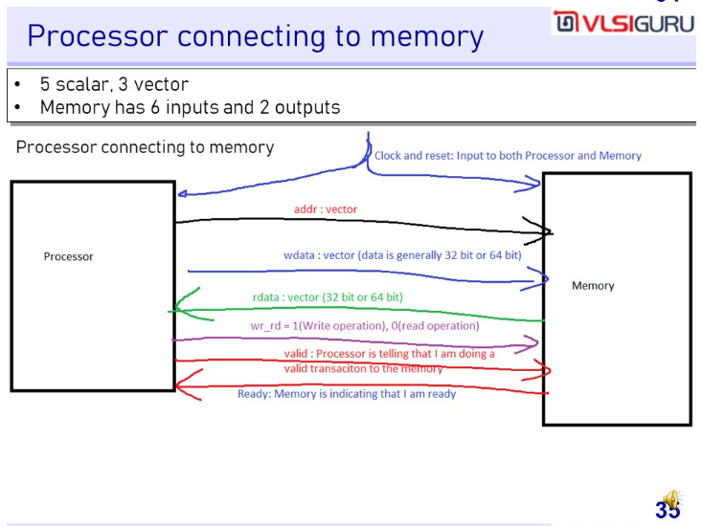

Slide 36
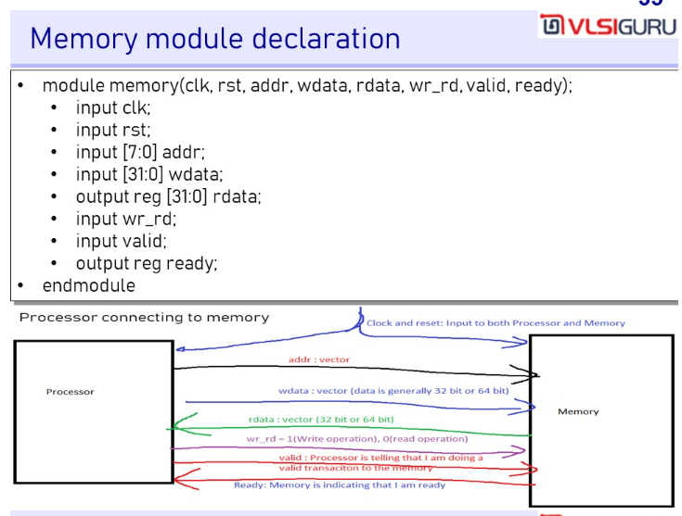

Slide 37
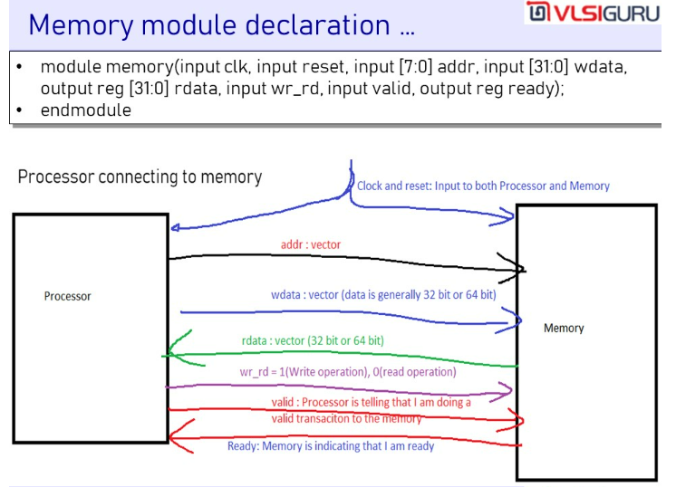

Slide 38
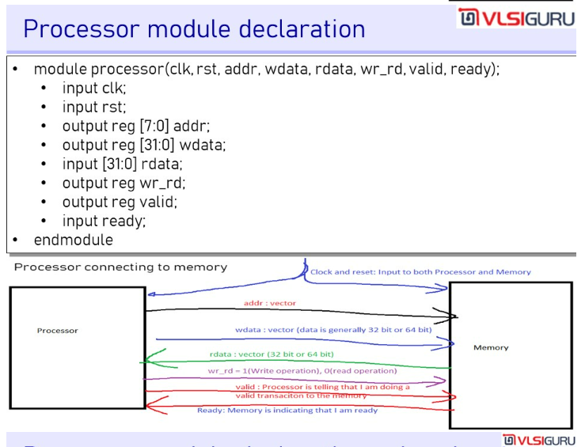

Slide 39
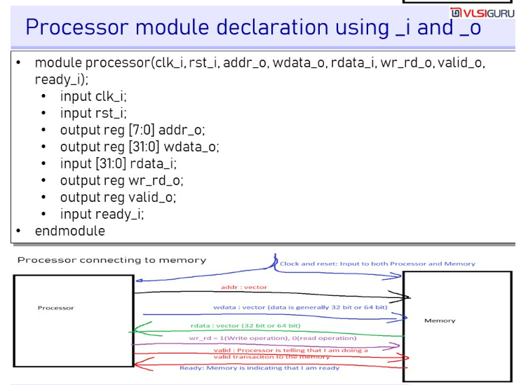

Slide 40
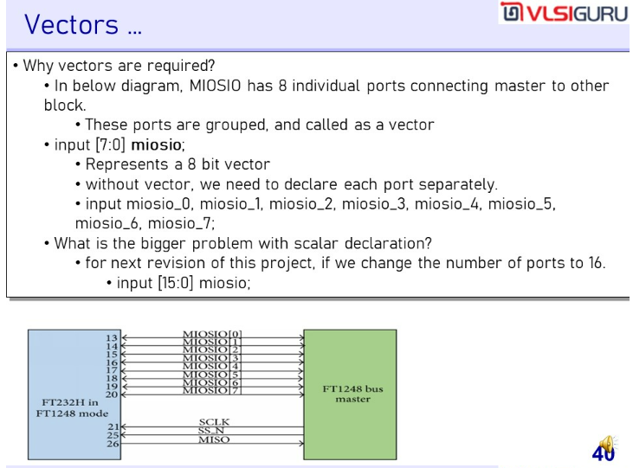

Slide 41
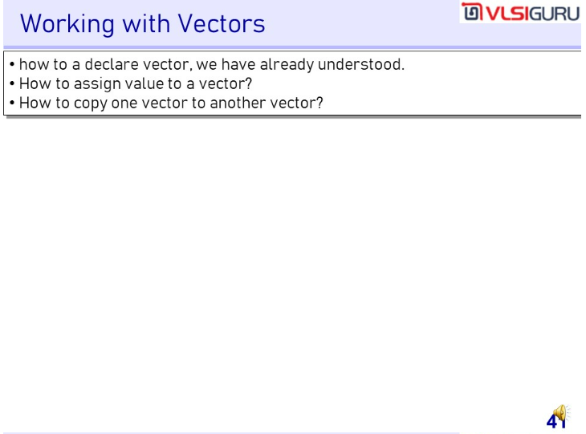

Slide 42
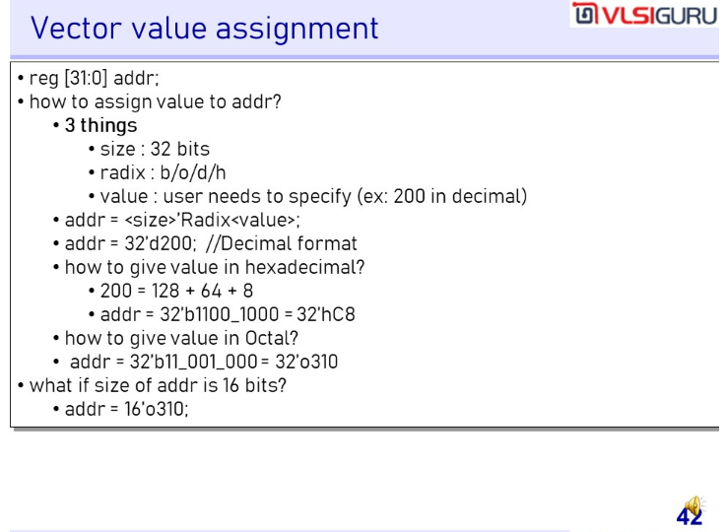

Slide 43
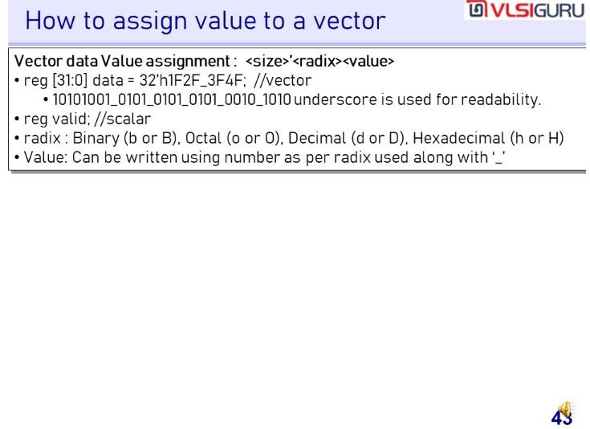

Slide 44
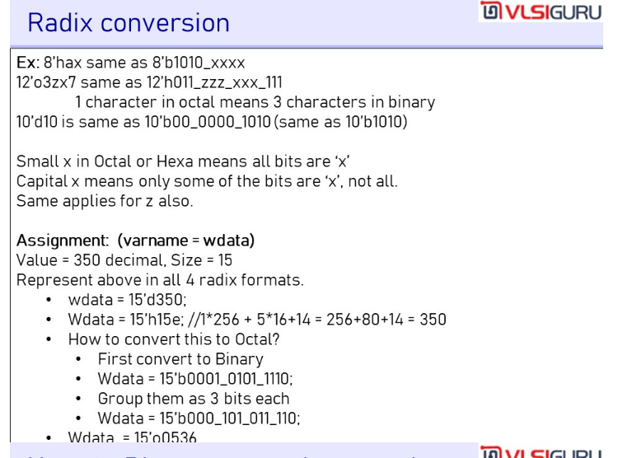

Slide 45
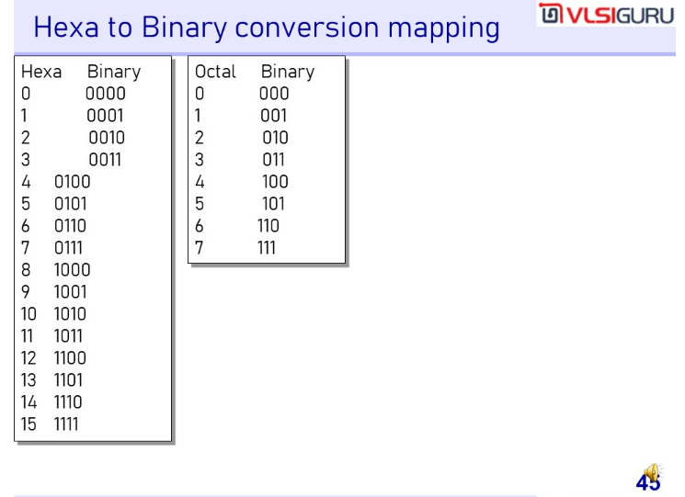

Slide 46
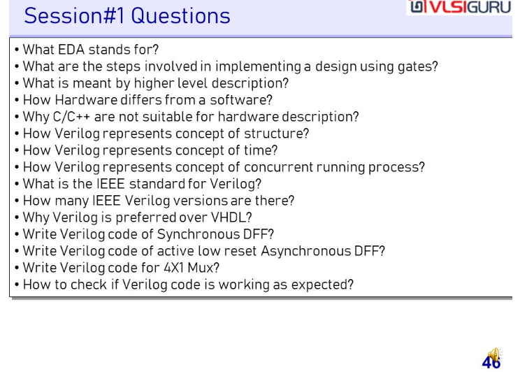

Slide 47
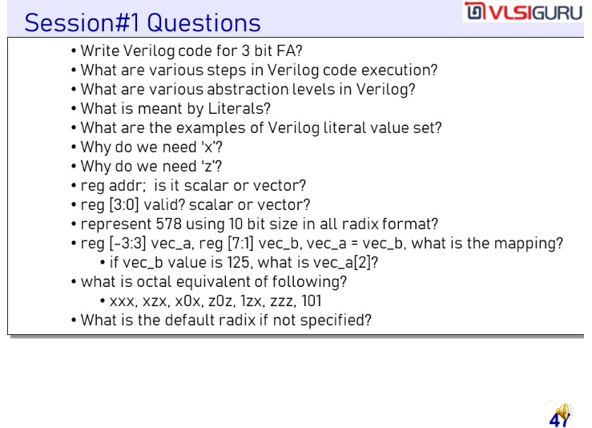

Slide 48
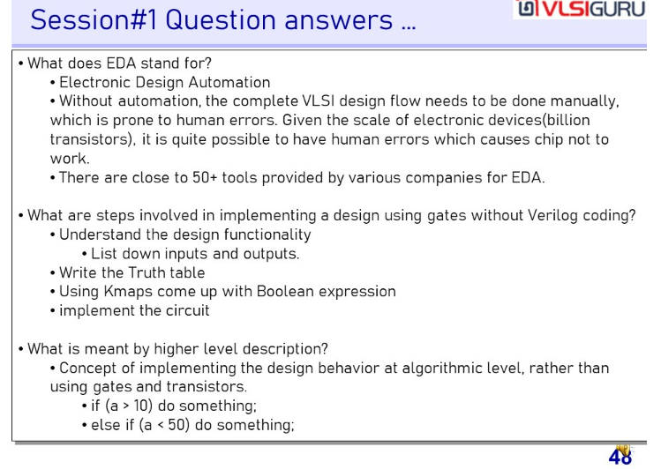

Slide 49
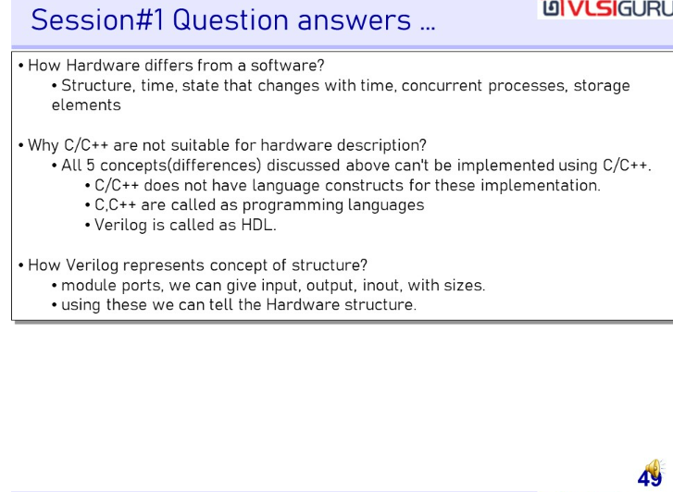

Slide 50
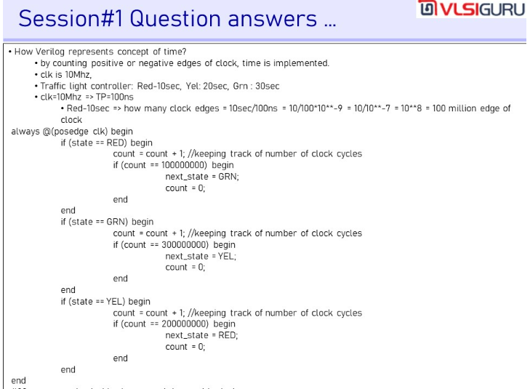

Slide 51
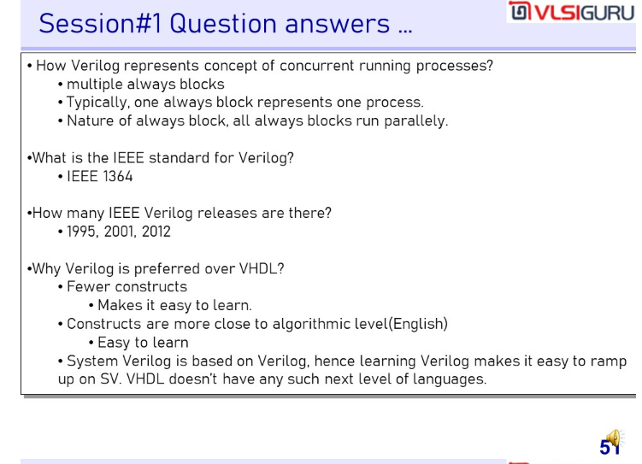

Slide 52
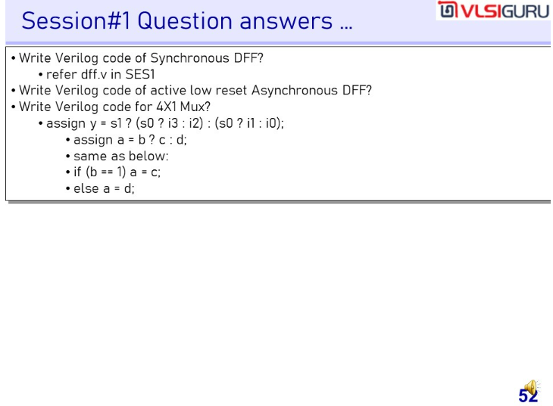

Slide 53
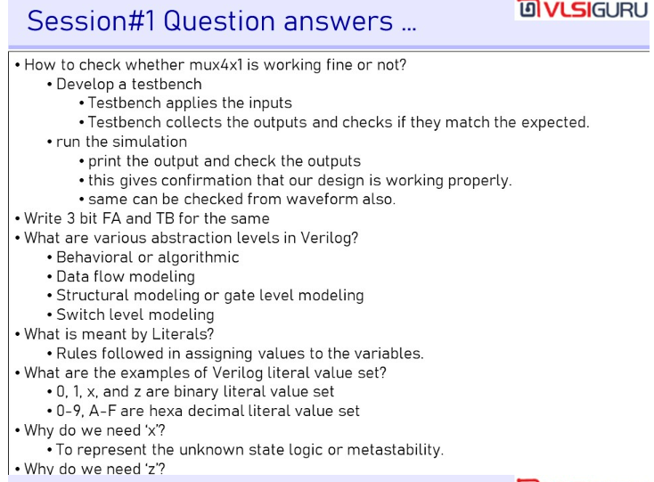

Slide 54


Slide 55


Slide 56


Slide 57


Slide 58


Slide 59


Slide 60


Slide 61


Slide 62


Slide 63


Slide 64


Slide 65


Slide 66


Slide 67


Slide 68


Slide 69


Slide 70


Slide 71


Slide 72


Slide 73


Slide 74


Slide 75


Slide 76


Slide 77


Slide 78


Slide 79


Slide 80


Slide 81


Slide 82


Slide 83


Slide 84


Slide 85


Slide 86


Slide 87


Slide 88


Slide 89


Slide 90


Slide 91


Slide 92


Slide 93


Slide 94


Slide 95


Slide 96


Slide 97


Slide 98


Slide 99


Slide 100


Slide 101


Slide 102


Slide 103


Slide 104


Slide 105


Slide 106


Slide 107


Slide 108


Slide 109


Slide 110


Slide 111


Slide 112


Slide 113


Slide 114


Slide 115


Slide 116


Slide 117


Slide 118


Slide 119


Slide 120


Slide 121


Slide 122


Slide 123


Slide 124


Slide 125


Slide 126


Slide 127


Slide 128


Slide 129


Slide 130


Slide 131


Slide 132


Slide 133


Slide 134


Slide 135


Slide 136


Slide 137


Slide 138

While running the simulation the time to write memory is very high, back door access gives very quick access to the memory during the simulation.
It is copying the data image to the memory. Note however that it is not a real world concept.

Slide 139


Slide 140


Slide 141


Slide 142
Handshaking using valid and ready
Valid and ready combinations
Valid = 1, ready = 0 → TB is giving valid transaction to memory, but memory is not ready to respond.
Valid = 0, ready = 1 → TB is not giving a valid transaction to memory, but memory is ready to respond.
Valid = 0, ready = 0 → TB is not giving a valid transaction to memory, memory is also not ready to respond.
Valid = 1, ready = 1 → Giving a valid transaction to memory, it is also ready to respond
Handshaking is initiated to say that, I want to give some information to you, other component conveys its readiness by driving ready = 1

Slide 143


Slide 144


Slide 145


Slide 146


Slide 147


Slide 148


Slide 149


Slide 150


Slide 151


Slide 152


Slide 153


Slide 154

When to declare reg or wire ?
Look for always and initial
List down all the variables used in the statements in the LHS
All those variables should be ‘reg’, any other variables in the code, must be ‘wire’.

Slide 155


Slide 156


Slide 157


Slide 158


Slide 159


Slide 160


Slide 161


Slide 162


Slide 163


Slide 164


Slide 165


Slide 166


Slide 167


Slide 168


Slide 169


Slide 170


Slide 171


Slide 172


Slide 173


Slide 174


Slide 175


Slide 176


Slide 177


Slide 178


Slide 179


Slide 180


Slide 181


Slide 182


Slide 183


Slide 184


Slide 185


Slide 186


Slide 187


Slide 188


Slide 189


Slide 190

Notice how assigning all positions of vectors is different for x/z and 1. That is replications works for x and z when defined as ‘bz and ‘bx but not for ‘b1.

Slide 191


Slide 192


Slide 193


Slide 194

This is important. See how y is assigned value using assign. This however is not possible with if-else

Slide 195


Slide 196


Slide 197


Slide 198


Slide 199


Slide 200


Slide 201


Slide 202


Slide 203


Slide 204

Fork-Join is non-synthesizable
If we want concurrent execution nature inside procedural block, then only option is fork join

Slide 205


Slide 206

This is very Important

Slide 207

This is very Important

Slide 208

This is very Important

Slide 209


Slide 210

This is very Important

Slide 211


Slide 212


Slide 213


Slide 214


Slide 215


Slide 216


Slide 217



Slide 218


Slide 219

assign a = if (b) c else d; // Not allowed
assign a = sum(b,c); // Not allowed
assign {co, s} = a+b+ci; //allowed
// LHS is concatenation of scalar and vector of nets. LHS cannot be reg
assign {a, b} = {c,d,e,f}; // allowed
Implement a 4X1 mux using assign ?
This is done using 2, 2X1 MUXes
assign out = S1 ? (S0 ? i3 : i2) : (S0 ? i1: i0);
I/p S0 S1 O/p
i0 0 0 i0
i1 0 1 i1
i2 1 0 i2
i3 1 1 i3
Similarly 8x1 Mux is
assign out = S2 ? (S1 ? (S0 ? i7 : i6) : (S0 ? i5: i4)) : (S1 ? (S0 ? i3 : i2) : (S0 ? i1: i0));

Slide 220


Slide 221


Slide 222


Slide 223


Slide 224


Slide 225

bufif1 (buffer if en=1). Tri-State buffers
notif0 and notif1 means output is inversed except same as bufif

Slide 226


Slide 227


Slide 228

assign statement is used to implement only combinational logic
always statement is used to implement combinational and sequential logic both

Slide 229


Slide 230


Slide 231


Slide 232


Slide 233


Slide 234


Slide 235


Slide 236

This is very important

Slide 237

Synthesis means converting code to gate level synthesis.
Synthesis tools will do this conversion
This is very important

Slide 238

This is very important

Slide 239

This is very important

Slide 240


Slide 241


Slide 242

// Ibrahim's Code
module dff (d, clk, res, q);
input d, clk, res;
output reg q;
always @ (posedge clk)
if (res == 1) q = 0;
else q = d;
endmodule
module sample (a, b, c, clk, res, y, w);
input a, b, c, res, clk;
output y, w;
wire n1, n2;
and u1 (n1, a, b);
not u2 (n2, c);
dff d1 (.d(n1), .clk(clk), .res(res), .q(y));
dff d2 (.d(n2), .clk(clk), .res(res), .q(w));
endmodule
// Sreenivasan's Code
module sample (a, b, c, clk, res, y, w);
input a, b, c, res, clk;
output reg y, w;
wire n1, n2;
always @(posedge clk) begin
if (rst == 1) begin
y = 0;
w = 0;
end
else begin
y = a & b;
w = ~c;
end
end
endmodule

Slide 243


Slide 244


Slide 245


Slide 246


Slide 247


Slide 248


Slide 249


Slide 250


Slide 251


Slide 252

This is very important, Q1, Q2, Q3 will hold just one value at the end of blocking statements hence just ONE D-FF will be inferred as for holding one value only one FF is required

Slide 253

Q1, Q2, Q3 will be holding 3 different values

Slide 254


Slide 255


Slide 256


Slide 257


Slide 258


Slide 259


Slide 260


Slide 261


Slide 262

We can use blocking statements inside the always block if there are no dependencies between the statements
Here x,y,z has no dependencies hence blocking statements can be used.

Slide 263

Why can’t we use non-blocking statements for combinational logic ?
Non-blocking statements uses old values (and not the updated values) hence it is not used in combinational logic
Combinational logics are continuously driven hence as soon as one input changes, output needs to be updated.

Slide 264


Slide 265


Slide 266


Slide 267


Slide 268


Slide 269


Slide 270


Slide 271


Slide 272

module mux8x1 (i0, i1, i2, i3, i4, i5, i6, i7, sel, y);
always @ (*) begin
if (sel == 3'b000) y = i0;
else if (sel = 3'b001) y = i1;
else if (sel = 3'b010) y = i2;
else if (sel = 3'b011) y = i3;
else if (sel = 3'b100) y = i4;
else if (sel = 3'b101) y = i5;
else if (sel = 3'b110) y = i6;
else if (sel = 3'b111) y = i7;
else y = 1'bx;
end
endmodule
module mux8x1 (i0, i1, i2, i3, i4, i5, i6, i7, sel, y);
always @ (*) begin
case (sel)
3'b000 : y = i0;
3'b001 : y = i1;
3'b010 : y = i2;
3'b011 : y = i3;
3'b100 : y = i4;
3'b101 : y = i5;
3'b110 : y = i6;
3'b111 : y = i7;
default : y = 1'bx;
endcase
end
endmodule

Slide 273


Slide 274


Slide 275


Slide 276


Slide 277

Very Important

Slide 278


Slide 279


Slide 280


Slide 281


Slide 282


Slide 283


Slide 284


Slide 285


Slide 286


Slide 287


Slide 288


Slide 289


Slide 290


Slide 291


Slide 292


Slide 293


Slide 294


Slide 295


Slide 296


Slide 297


Slide 298


Slide 299


Slide 300


Slide 301


Slide 302


Slide 303


Slide 304


Slide 305


Slide 306


Slide 307


Slide 308


Slide 309


Slide 310


Slide 311


Slide 312


Slide 313


Slide 314


Slide 315

This is very important. Shows the significance of time precision

Slide 317


Slide 318

This is very important.
At 8ns a is getting updated hence simulation will enter the always block.
Also notice that a is changing(sensitivity list) before getting assigned to b but b will not be change as simulation is not entering always block before current simulation gets completed and hence b will not change
Value of a is captured 10ns agao but is assigned to b after 10ns

Slide 319

This is very important.
The value of a is captured after 10ns delay and assigned to b whatever is the current value of a

Slide 320


Slide 321

$itor – Integer to Real
$ator – Ascii to Real

Slide 322


Slide 323


Slide 324


Slide 325


Slide 326

%m prints hierarchy and value both. %d, %f both prints value only

Slide 327


Slide 328


Slide 329


Slide 330


Slide 331


Slide 332


Slide 333


Slide 334


Slide 335


Slide 336


Slide 337


Slide 338


Slide 339


Slide 340


Slide 341


Slide 342


Slide 343


Slide 344


Slide 345


Slide 346


Slide 347


Slide 348


Slide 349


Slide 350


Slide 351


Slide 352


Slide 353

$value$plusargs is elaboration time argument. We used to pass value in vsim that is during elaboration time

Slide 354


Slide 355


Slide 356


Slide 357


Slide 358


Slide 359


Slide 360


Slide 361


Slide 362


Slide 363


Slide 364


Slide 365


Slide 366

primitive mux2x1(y, i1, i0, sel);
input i1, i0, sel;
output y;
table
//inputs : outputs;
//i1 i0 sel y
? 0 0 : 0;
? 1 0 : 1;
0 ? 1 : 0;
1 ? 1 : 1;
endtable
endprimitive

Slide 367


Slide 368


Slide 369


Slide 370


Slide 371


Slide 372


Slide 373


Slide 374


Slide 375


Slide 376


Slide 377


Slide 378


Slide 379


Slide 380


Slide 381


Slide 382


Slide 383


Slide 384


Slide 385


Slide 386


Slide 387


Slide 388


Slide 389


Slide 390


Slide 391


Slide 392


Slide 393


Slide 394


Slide 395


